Slide 1
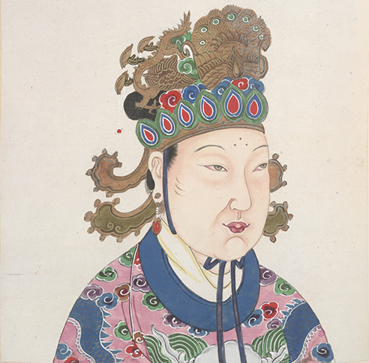
Civilizations of Asia (500-1650)
Lesson 2 Golden Ages in China: Tang and Song Dynasties

Slide 2
Civilizations of Asia (500-1650)
Lesson 2 Golden Ages in China: Tang and Song Dynasties
Learning Objectives
Summarize how the Tang dynasty reunified China.
Explain how the Song dynasty grew rich and powerful despite military setbacks.
Understand how China created an ordered society.
Describe the major cultural developments in the Tang and Song dynasties.

Slide 3
The Tang Dynasty Restores China to Glory
The Han Dynasty Collapses
China will not fall apart when the Han collapse
Farm production will expand, technology slowly improves, Buddhism will spread, learning and the arts will flourish
Sui dynasty (589-618) will briefly unite north and south China
Building an Empire
1st Tang emperor (Li Yuan) was a general under the Sui
When empire starts to collapse his son advises rebellion
They will set up the Tang dynasty
8 yrs later his son (Li Shimin) will ask his father to step down and he will become emperor taking the name Tang Taizong
Later rulers will take central Asia, and will make Tibet, Vietnam, and Korea become tributary states
Students from Korea and Japan will travel to the Tang capital to learn about Chinese govt., law, and arts

Slide 4
The Tang Dynasty Restores China to Glory
Strengthening the Government and Economy
Tang rulers help restore the Han system of govt.
They rebuilt the bureaucracy and enlarged the civil service system for people trained in Confucian philosophy
They instituted land reform, breaking up large tracts of lands and giving it to peasants. This created more tax revenue and made landowners weaker
Decline of the Dynasty
Tang emperors lost lands to Arabs in Central Asia
Corruption, high taxes, drought, famine, and rebellion all occurred
In 907 a rebel general will overthrow the last Tang emperor

Slide 5
The Tang Dynasty Restores China to Glory
Wu Zhao rose from a lowly position at court to a position of influence over the Tang emperor. Upon his death, she became the first woman to claim the throne.

Slide 6
The Song Dynasty
Song Achievements
The Chinese economy expanded under the Song
Farmers, with a new type of rice crop, could now grow 2 crops, one for food the other for cash
Rise in productivity allowed people to pursue commerce, learning, and the arts.
This lead to new technology like an improved compass, shipbuilding innovations, and gunpowder
The Growth of Trade
Foreign trade flourished
Government issued paper money to facilitate trade
Chinese cities became centers of trade with pop hitting 1 mil
4,000 mile Silk Road which linked China, India, Persia, Middle East
It spread technology, science, math, religious beliefs, music
Chinese govt promoted trade through canals
Grand Canal will connect south of China to the North

Slide 7
The Song Dynasty
Advances in Science and Technology
Under Tang and Song Golden Age of technology
Chinese made breakthroughs in astronomy, agriculture, medicine, and military technology
Gunpowder is going to be used in canons and other fire arms
Moveable text is going to be invented to help print things faster
Magnetic compass will help sailors at sea
Mechanical clocks will be invented to take exact time

Slide 8
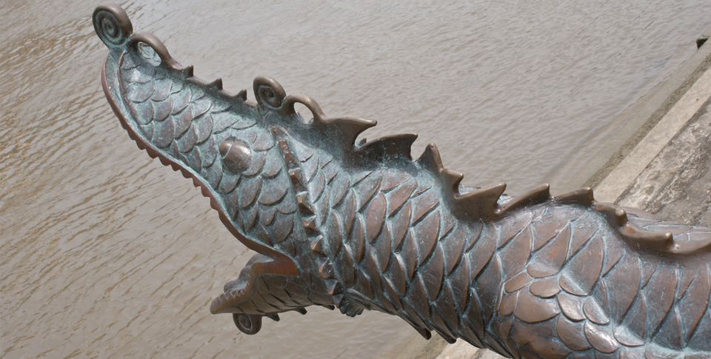
The Song Dynasty
The invention of gunpowder made possible the cannon, such as this one with a dragon head at its mouth.

Slide 9
An Ordered Society
The Bureaucracy
Under the Tang and Song dynasty the bureaucracy continues to develop. Power starts to move away from the aristocrats to the scholar gentry who become govt officials
The bureaucracy had many dept. such as tax collecting, revenue, mathematics, astronomy, and medicine
The Gentry
The Gentry stood at the top of Chinese society
The Song scholar gentry supported a revival of Confucian thought
The ideal Confucian official was wise, kind, selfless, virtuous scholar who knew how to ensure harmony in society
Peasants
Most Chinese were peasants
They lived in small self sufficient villages and handled their affairs
Peasants could move up in society through education and govt service.

Slide 10
An Ordered Society
Merchants: Prosperous but Lowly
Under Confucian tradition merchants had a lower status b/c their riches came from the labor of others
Confucian attitude toward merchants affected economic policy
Some rulers sought to control commerce and other to restrict foreign merchants. Trade still continued to flourish
Status of Women
Within the home women were called upon to run family affairs
Still boys were more valued than girls b/c upon marriage women joined their husband’s family and could not keep her dowry
If widowed, she could not remarry
Foot binding started in the later Song dynasty starting with imperials but spreading to lower classes
Not all will bind feet, peasants needed them to work fields

Slide 11
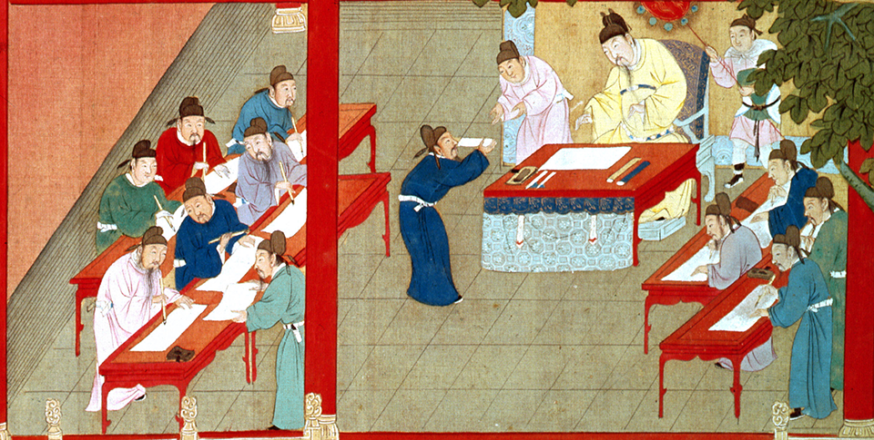
An Ordered Society
Candidates take the rigorous civil service exam during the Song dynasty. Students studied for years in preparation for the exam, which usually led to an honored position as a civil servant in the bureaucracy.

Slide 12
The Rich Culture of Tang and Song China
Seeking Balance and Harmony in Nature
Poetry, painting, and calligraphy were essential skills for the scholar gentry.
During the Song dynasty Chinese landscaping art was big
Daoist tradition sought to capture the spiritual essence of the natural world
Art included misty mountains, bamboo forest, but also emperor portraits and lively scenes of city life
Sculpture and Architecture
Buddhist themes dominated sculpture and influenced Chinese architecture
Chinese sculptors made Buddha look like a Chinese god rather than an Indian holy man
The Indian stupa evolved into the graceful Chinese pagoda, a multistoried temple with eaves that curve up at the corner

Slide 13
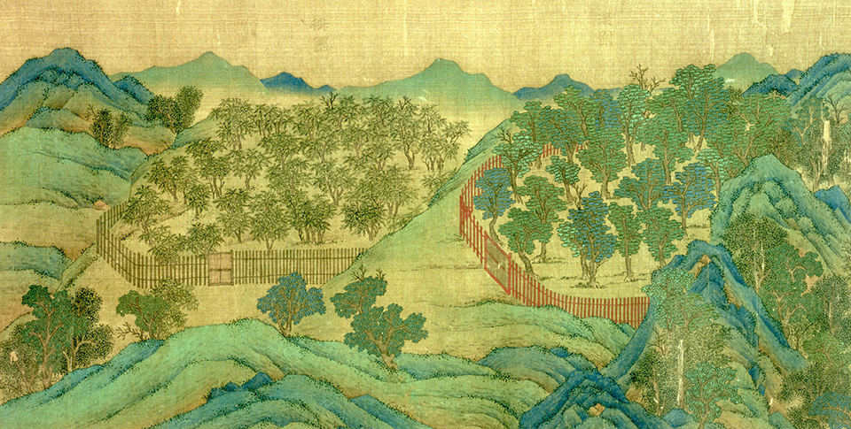
The Rich Culture of Tang and Song China
Song paintings emphasized the Daoist belief in the importance of harmony with nature. Paintings often portrayed a harmonious blend of trees, mountains, and rivers.

Slide 14
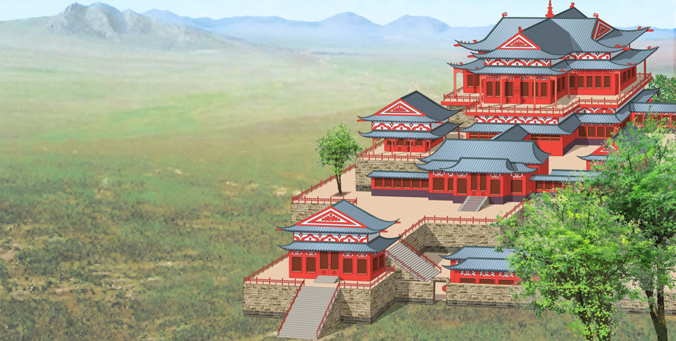
The Rich Culture of Tang and Song China
Homes of the nobility and wealthy were often designed along the lines of Buddhist temples. The homes included lovely courtyards and gardens, as well as guest rooms and banquet halls.

Slide 15
The Rich Culture of Tang and Song China
Porcelain
The Chines perfected techniques that made porcelain, a hard shiny pottery, the best in the world
Artists produced porcelain figures of camels, women playing polo, and bearded foreigners coming from the Silk Road
Chinese Literature
Scholars produced work on philosophy, history, and religion
Among the gentry poetry was the most respected form of Chinese literature
We know the names of 200 major and 400 minor Tang and Song poets
Their works touched on Daoist and Buddhist themes, social issues, shortness of life, and immensity of the universe
Greatest Tang poet was Li Bo, writing 2k poems about harmony with nature or lamenting the passage of time

Slide 16
Quiz: The Tang Dynasty Restores China to Glory
How did the Tang land reform policy strengthen the central government?
A. by allowing peasants to own the land they worked
B. by breaking up the localized power of large landowners
C. by increasing revenue through more land taxes
D. by creating more civil service employees who owed their positions to the central government

Slide 17
Quiz: The Song Dynasty
How was the Song dynasty able to continue its prosperity despite threats from the north?
A. More productive farming created surplus food, which could be sold.
B. The government’s issuance of paper money created more wealth.
C. Technology innovations such as gunpowder and the compass led to industrialization.
D. The Great Wall and the Grand Canal allowed major cities to remain unoccupied.

Slide 18
Quiz: An Ordered Society
How did the social status of merchants reflect Chinese ideas about society?
A. They had low status because many merchants were women.
B. They had low status because their wealth came from the work of other people.
C. They had high status because they could interact on an equal footing with foreign merchants.
D. They had high status because most of them were wealthy.

Slide 19
Quiz: The Rich Culture of Tang and Song China
Which of the following is an important theme in Tang and Song paintings?
A. the glories of war
B. a balance of color and light
C. personal achievement
D. the spiritual essence of nature

